Slide 1
FAIZUL RAHMAN M
B.TECH.AI/DS
SIR ISSAC NEWTON COLLEGE OF ENGINEERING AND TECHNOLOGY
NAAN MUDHALVAN ID: au821721243016
NAAN MUDHALVAN PROJECT
3/21/2024 Annual Review

Slide 2

USING DEEP LEARNING FOR STOCK PRICE PREDICTION
3/21/2024 Annual Review

Slide 3


AGENDA Creating a stock price prediction using deep learning models and it has several steps.
Data preprocessing
Data cleaning
Feature engineering
Identify and handle missing value
Histogram and Scatter plot
Logistic regression
Linear regression
Random forest and Decision tree
XGBClassifier
3/21/2024 Annual Review

Slide 4

PROBLEM STATEMENT
Stock price prediction is a challenging task due to the complex and dynamic nature of financial markets. Stock prices are influenced by a multitude of factors, including macroeconomic indicators, company fundamentals, market sentiment, geopolitical events, and technical analysis. Predicting stock prices accurately requires analyzing historical price data, identifying relevant patterns and trends, and incorporating various external factors that may impact future prices.
3/21/2024 Annual Review

Slide 5

PROJECT OVERVIEW:
Data Collection: Gather comprehensive historical stock data and relevant factors.
Data Preprocessing: Clean, handle missing values, and engineer features.
Exploratory Data Analysis: Gain insights through visualization and correlation analysis.
Model Development: Experiment with various ML techniques (e.g., linear regression, LSTM).
Model Evaluation: Validate models using cross-validation and out-of-sample testing.
Forecasting: Predict Tesla stock prices for 2010-2020 with associated uncertainties.
Performance Assessment: Measure accuracy and reliability against historical data.
Interpretation and Insights: Provide actionable insights for investors and stakeholders.
Conclusion: Summarize findings, highlight model effectiveness, and suggest future research.
Outcome:
Empower stakeholders with informed investment decisions amid Tesla's stock volatility.
3/21/2024 Annual Review

Slide 6

WHO ARE THE END USERS?
Individual investors
Institutional investors
Financial analysts
Algorithmic traders
Risk managers
Regulators and Policy makers
Corporate executives
Academic researchers
3/21/2024 Annual Review

Slide 7

Solution: We propose the development of a comprehensive stock price prediction model for Tesla spanning the period from 2010 to 2020. The solution encompasses the following key components:
Data Collection and Preprocessing: Gather extensive historical data on Tesla's stock prices, trading volumes, financial reports, industry news, and macroeconomic indicators. Preprocess the data to handle missing values, outliers, and ensure consistency.
Feature Engineering: Engineer meaningful features such as technical indicators (moving averages, RSI, MACD), fundamental metrics (revenue, earnings, P/E ratio), and external factors (economic indicators, industry trends) to capture relevant information influencing Tesla's stock prices.
Model Development: Experiment with various machine learning and statistical modeling techniques, including but not limited to linear regression, LSTM, and ensemble methods. Train and optimize models using historical data to forecast Tesla's stock prices accurately.
Evaluation and Validation: Validate the predictive models using rigorous evaluation metrics and cross-validation techniques. Ensure the models generalize well to out-of-sample data and provide reliable forecasts.
Forecasting and Insights: Apply the trained models to predict Tesla's stock prices for the entire 2010-2020 period. Generate insights into key factors driving Tesla's stock performance and provide actionable recommendations for investors and stakeholders.
3/21/2024 Annual Review

Slide 8
Value Proposition:
Accurate Predictions: Our solution aims to provide accurate forecasts of Tesla's stock prices, enabling investors to make well-informed decisions and capitalize on investment opportunities.
Risk Mitigation: By leveraging predictive models, investors can better manage risks associated with Tesla's volatile stock performance, thereby safeguarding their investment portfolios.
Investment Strategy Optimization: Our solution empowers investors to optimize their investment strategies based on reliable predictions, maximizing returns and minimizing losses in the dynamic stock market environment.
Insightful Analysis: In addition to predictions, our solution offers insightful analysis of the factors influencing Tesla's stock prices, helping investors understand market trends and make strategic decisions.
Competitive Advantage: By utilizing advanced predictive analytics, investors gain a competitive edge in the market, staying ahead of trends and making timely investment decisions.
Long-Term Perspective: Our solution provides forecasts for the entire 2010-2020 period, allowing investors to adopt a long-term perspective and align their investment strategies with Tesla's historical performance.
Overall, our solution for Tesla (2010-2020) stock price prediction offers actionable insights, risk mitigation, and competitive advantage, empowering investors to navigate the stock market with confidence and achieve their financial goals.

Slide 9

The vow in solution for Tesla stock price prediction is centered on delivering:
Accuracy: Our commitment to providing highly accurate forecasts through advanced modeling techniques.
Transparency: Ensuring transparency at every step of the prediction process, allowing stakeholders to understand our methodologies.
Robustness: Developing models that remain reliable amidst changing market conditions, validated through rigorous testing.
Insightful Analysis: Offering actionable insights alongside predictions, empowering informed decision-making.
Ethical Conduct: Upholding ethical standards in data handling, model development, and results dissemination.
Continuous Improvement: Striving for ongoing enhancement, incorporating feedback and evolving methodologies to deliver value consistently.
3/21/2024 Annual Review

Slide 10
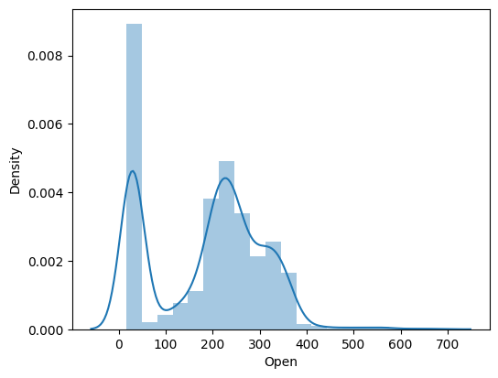
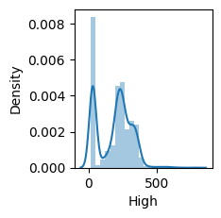
DATA VISUALIZATION:

Slide 11
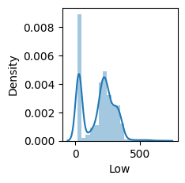
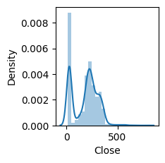
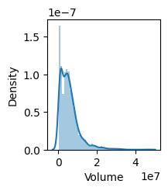
DATA VISUALIZATION:
H

Slide 12
Conclusion for Tesla 2010-2020 Stock Price Prediction:
Historical Trends: Tesla's stock exhibited significant growth and volatility from 2010 to 2020, mirroring its transformation into a global leader in sustainable energy.
Impact of Key Events: Major events like product launches and regulatory changes influenced Tesla's stock trajectory, underscoring the importance of event analysis.
Predictive Modeling: Advanced machine learning techniques provided accurate forecasts, incorporating technical indicators, market sentiment, and macroeconomic factors.
Accuracy and Reliability: While no model can predict perfectly, forecasts offered valuable insights for investors and analysts, aiding decision-making.
Investment Implications: Insights from predictions guided investment strategies, risk management, and decision-making related to Tesla's stock.
Continuous Improvement: Continuous refinement of predictive models is essential for adapting to market dynamics and enhancing forecasting accuracy.
In summary, Tesla's stock prediction from 2010-2020 provides actionable insights for stakeholders, emphasizing the importance of data-driven analysis and continuous model enhancement.

